Slide 1

ECEN 361
Real-Time and Embedded Systems
SW Architectures and Lab Tools

Slide 2
Embedded Software Architectures
All embedded systems are designed to handle different kinds of events
button press
sensor reading
network data traffic
timer expires
etc

Slide 3
Defn - Event Handlers
Event handlers are procedures or functions (typically written in C) that do the “work” to respond to these events
The Embedded Software Architecture determines how
the event is detected
the event handler is called
Events
Handlers
Architecture

Slide 4
Embedded Software Architectures
There are 4 main SW architectures used in embedded systems
Round Robin
Round Robin with Interrupts
Function Queue Scheduling
Real Time Operating System
Each of these architectures handle the events differently

Slide 5
Architecture 1: Round-Robin No interrupts required
One Event
while(1)
{
if (event)
handle_event();
}
Multiple Events
while(1)
{
if (event_1)
handle_event1();
if (event_2)
handle_event2();
...
if (event_n)
handle_eventn();
}
This is also called polling
What are the advantages/disadvantages of Round Robin?

Slide 6
Characteristics of Round-Robin
Advantage:
Simplicity: really just a single task, no shared data, no ISRs, no OS’s
Disadvantages:
Worst-case response time - one full iteration of loop (possibly handling all other events first)
Response time for every event is terrible if any single event requires lengthy processing
System is fragile: adding a single new event handler may cause deadlines to be missed for other events
Priorities available
None: actions are all equal; each handler must wait its turn

Slide 7
How to decrease response time?
while(1)
{
if (event1)
handle_event1();
if (event2)
handle_event2();
if (event1)
handle_event1();
if (event3)
handle_event3();
if (event1)
handle_event1();
if (event4)
handle_event4();
}
while(1)
{
if (event1)
handle_event1();
if (event2)
handle_event2();
if (event3)
handle_event3();
if (event4)
handle_event4();
}
How can I reduce the response time for event 1?

Slide 8

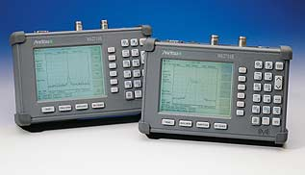
Application of Round-Robin
Digital Multimeter
Hand-Held Spectrum Analyzer
Round Robin good for
Few input devices/events to respond to
Response time constraints not demanding
No lengthy processing required

Slide 9
Architecture 2: Round-Robin with Interrupts
Add interrupts to single polling loop
Have ISRs do some work
Remainder done by functions called in loop
ISR sets flag to indicate that processing is required
Offers greater flexibility
Time critical response can be done in ISR
Longer-running code can be done in handlers

Slide 10
Round Robin with Interrupts
while(1)
{
if (flagA) {
flagA = 0;
handle_eventA();
}
if (flagB){
flagB = 0;
handle_eventB();
}
if (flagC){
flagC = 0;
handle_eventC();
}
}
ISR_A
{
// do some A stuff
flagA = 1;
}
ISR_B
{
// do some B stuff
flagB = 1;
}
ISR_C
{
// do some C stuff
flagC = 1;
}
What is flagA?
Work split between ISR
and task code.
What are the advantages/disadvantages of Round Robin w/ Interrupts?

Slide 11
Characteristics of Round-Robin with Interrupts
Advantages
Work performed in ISRs has higher priority
ISR response time stable through most code changes
Disadvantages
ISRs and handlers will share data, shared data problems will appear (will discuss next week)
Handler response time not stable when code changes
Priorities available:
interrupts are serviced in priority order
all other actions have equal priority (none more important than rest)
Worst-case response time
For ISR - execution time for higher priority ISRs
For handler - sum of all other handlers + execution time for interrupts

Slide 12
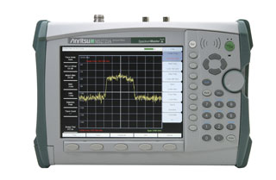
Application of RR w/ Interrupts
Hand-Held Spectrum Analyzer – Gen 2
RR w/ Interrupts good for
Med # input devices/events to respond to
Response time constraints not too demanding
No lengthy processing required

Slide 13
Architecture 3: Function-queue scheduling
What is a function pointer?
Work split
between ISR
and task code
Order of tasks
is dynamic
Queue can be
FIFO or sorted
by priority
ISR_A
{
// do some work relating to A
queue_put(handle_eventA);
}
ISR_B
{
// do some work relating to B
queue_put(handle_eventB);
}
while(1)
{
while(queue_empty()) // wait
task = get_queue();
task();
}

Slide 14
Characteristics of Function-queue scheduling
Advantages
improved response-time stability when code changes
Disadvantages
increased complexity: must implement a function queue
Priorities available
interrupts are serviced in priority order
tasks can be run in priority order
Worst-case response time for task
just started executing another task, have to wait
longest task time + execution time for ISRs
Just FYI - I have never seen this architecture used in industry

Slide 15
Architecture 4: Real-time operating system (RTOS)
What is an OS? What does it really do?
RTOS
Work is split between ISRs and tasks
Tasks are prioritized and run by a scheduler
Highest priority task is always the “running” task
If higher priority task becomes ready to run, other tasks are preempted
ISRs can cause tasks to become unblocked
Tasks can block when they are waiting for events
Tasks can delay themselves for fixed time intervals
RTOS contains code to
Create tasks, block and unblock tasks, schedule tasks, allow tasks and ISRs to communicate, etc

Slide 16
RTOS Architecture
ISR for
Event 1
Task A
ISR for
Event 2
Task B
RTOS
ISR for
Event 3
Task C
:
:
:
:

Slide 17
RTOS Characteristics
Advantages:
Stability when code changes: adding a lower-priority task will not affect response time of tasks with higher priorities
Many commercial RTOSs available
Disadvantages:
Software complexity (but much of complexity in RTOS)
Runtime overhead of RTOS
Priorities available
interrupts are serviced in priority order
tasks are serviced in priority order - lower priority tasks are preempted
Worst-case response time for highest-priority task
sum of interrupt execution times (other tasks preempted)

Slide 18
Priority Levels of Different Architectures
High Priority Processing
Device A ISR
Device A ISR
Device B ISR
Device B ISR
Device ... ISR
Device ... ISR
Device x ISR
Everything
Device x ISR
Task Code 1
All Task Code
Task Code 2
Task Code ...
Task Code x
Low Priority Processing
Round-Robin
Round-Robin w/ Interrupts
Real Time Operating System

Slide 19
Factors in choosing a SW Architecture
How much control do you need over system response time?
absolute response time requirements
other processing requirements (speed of uproc)
How many different events do you have to respond to?
different deadlines
different priorities

Slide 20
Selecting an Architecture
Select the simplest architecture that will meet your current and future response time requirements
If you have difficult response-time requirements, you should lean toward using an RTOS
Many to choose from, debugging support, etc.
You can also construct architectural hybrids
An RTOS where one task does polling
RR w/ interrupts: main loop polls slower HW directly

Slide 21
Pointers
In ECEN 260, how did we send data to a particular memory/IO location?
How can you do this in C?
More specific, how can you get a pointer to point to a particular memory location?
uint32 *p = (uint32 *)0x400000;

Slide 22
Function Pointers
While many programming languages support the concept of pointers to data, only a few enable you to define pointers to code -- that is, pointers that point to functions.
Originally introduced in C, pointers to functions are widely used in C++
Unfortunately, their cumbersome syntax baffles both novices and experienced programmers.

Slide 23
What are function Pointers?
C does not require that pointers only point to data, it is possible to have pointers to functions
Functions occupy memory locations therefore every function has an address just like each variable

Slide 24
Define a Function Pointer
A function pointer is nothing else than a variable, it must be defined as usual.
Eg,
int (*funcPointer) (int, char, int);
funcPointer is a pointer to a function.
The extra parentheses around (*funcPointer) is needed because there are precedence relationships in declaration just as there are in expressions

Slide 25
Assign an address to a Function Pointer
//assign an address to the function pointer
int (*funcPointer) (int, char, int);
int firstExample ( int a, char b, int c){
printf(“ Welcome to the first example”);
return a+b+c;
}
funcPointer= firstExample; //assignment
funcPointer=&firstExample; //alternative using address operator

Slide 26
Calling a function using a Function Pointer
There are two alternatives
Use the name of the function pointer
Can explicitly dereference it
int (*funcPointer) (int, char, int);
// calling a function using function pointer
int answer= funcPointer (7, ’A’ , 2 );
int answer=(* funcPointer) (7, ’A’ , 2 );

Slide 27
Arrays of Function Pointers
C treats pointers to functions just like pointers to data therefore we can have arrays of pointers to functions
This offers the possibility to select a function using an index
Eg.
suppose that we’re writing a program that displays a menu of commands for the user to choose from. We can write functions that implement these commands, then store pointers to the functions in an array:

Slide 28
Arrays of Function Pointers
void (*file_cmd[]) (void) =
{ new_cmd,
open_cmd,
close_cmd,
save_cmd ,
save_as_cmd,
print_cmd,
exit_cmd
};
If the user selects a command between 0 and 6, then we can subscript the file_cmd array to find out which function to call
file_cmd[n]();

Slide 29
Testing and Debugging
Oscilloscope
Shows electrical details
Benefits: Wideband, accurate
Disadvantages: < 4 inputs; triggering
Logic analyzer
Shows 0/1 - according to some threshold
Benefits: Many channels, trigger on patterns
Disadvantages: Idealized waveforms, insufficient access
3. Embedded test
You design in built-in test features
Benefits: Only way to test large chips
Disadvantages: Uses chip area, incomplete scan, difficult design

Slide 30
Oscilloscope
Samples signal voltage over time
Displays signal as a waveform, one voltage value per time step\
Triggering
Choose when to start sampling the signals
Slope: rising voltage/falling voltage
Threshold: trigger when signal reaches this value
Repeat mode
Assume that signal is periodic
Repeated triggering captures the same signal
You’ll never see a glitch
Capture mode
Triggers only once, stores waveform in memory
You’ll be very lucky to catch a glitch

Slide 31
Logic analyzers
Instruments for acquiring digital data
Wide data “bus” - capture many signals
Memory stores bus data
Smart triggering decides what data to store
Embedded computer processes the data
We use the Logitech
128 channels
32k memory per channel
100MHz state
2GSPS sampling

Slide 32
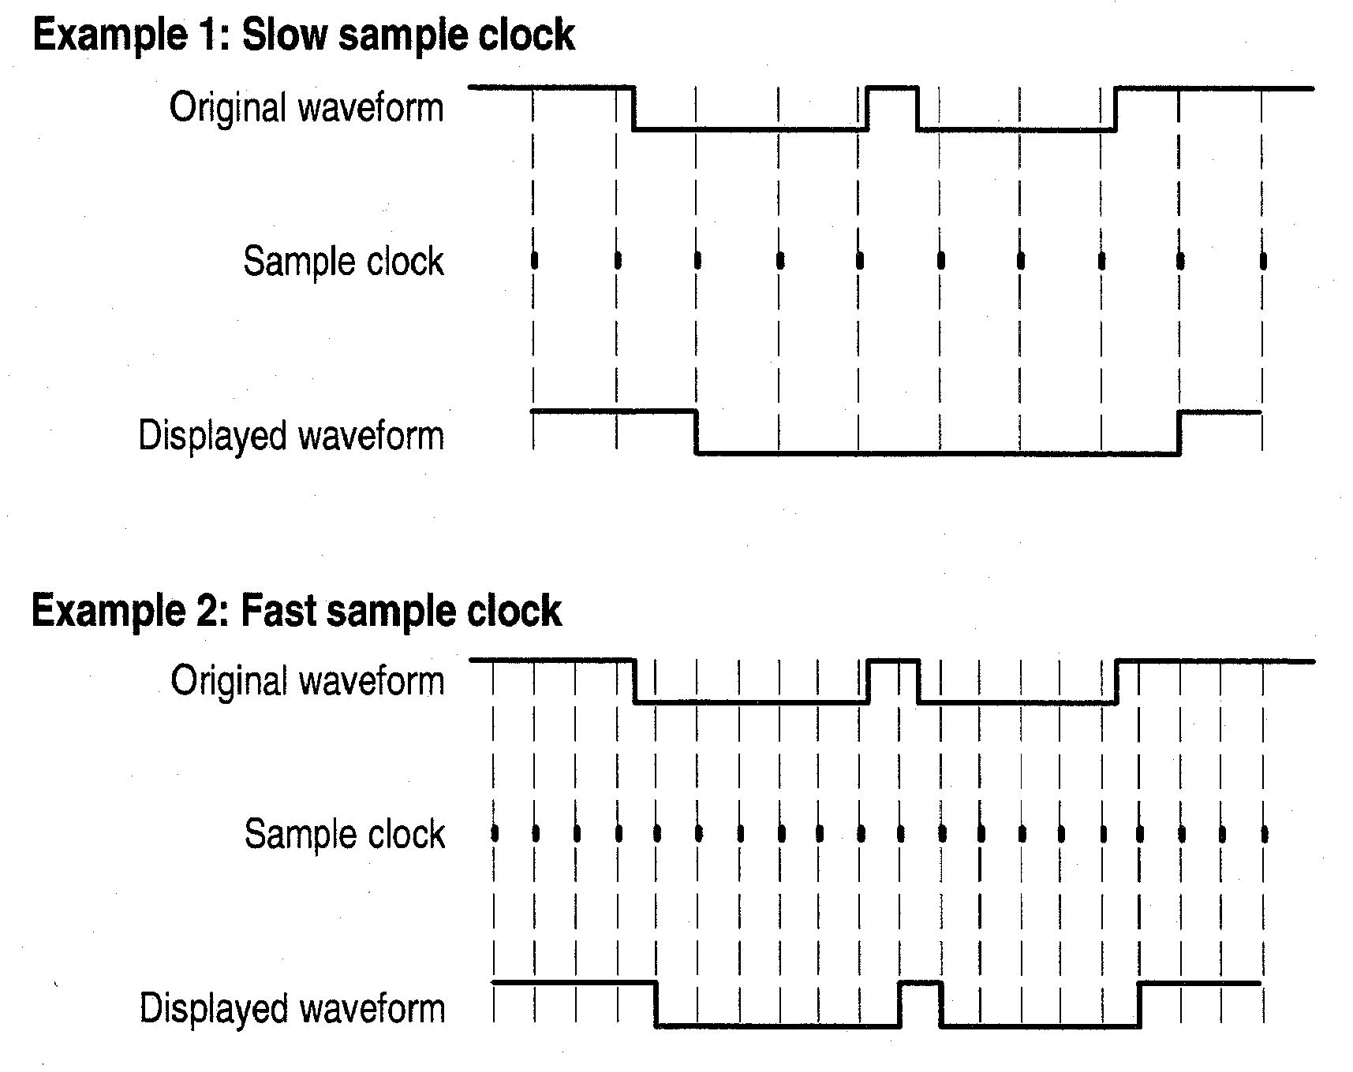
Clocking a logic analyzer
Samples data every clock cycle
External/synchronous clocking
You supply the clock
Use when you need to see long data records
Analyzer stores one sample per clock period
Internal/asynchronous clocking
Analyzer supplies the clock
4ns to 50ms
Use when you need to see precise timing
Find glitches

Slide 33
Triggering and acquisition
Derive trigger from sampled data
Data values
Data ranges
Signals from another module
Internal counters
Data acquisition is continuous
Memory is a circular buffer
New samples continually overwrite oldest samples
Trigger tells the acquisition to stop
Triggers can qualify acquisition
Store only selected data

Slide 34
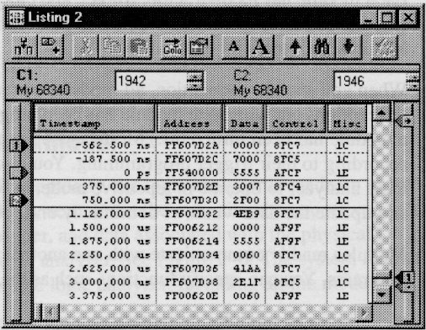
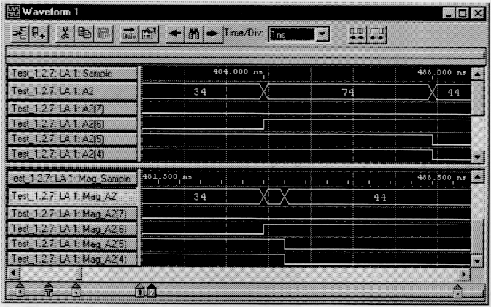
Data windows
Many types
Listing window
Waveform window
Histogram window
Source-data window
Features common to all
Cursors
Flags
Scroll
Search

Slide 35
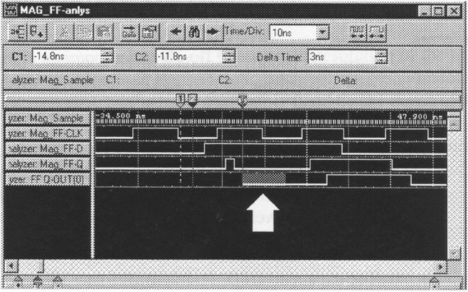
Capturing glitches
Trigger on the glitch
Triggering looks for multiple transitions in a clock cycle
Captures dynamic hazards
Can also trigger on setup and hold violations

